Slide 1
Portable system for detecting plant stress and Image Processing

Slide 2

Supervisor
Team :
Nageshwar kumar
(2022uee0138@iitjammu.ac.in)
2. Saurav Kumar
(2022uee0150@iitjammu.ac.in)
3. Jejariya Ajay Bhai
(2022uee0133@iitjammu.ac.in)
4. Aashish kumar Singh
(2022uee0116@iitjammu.ac.in)
5. Saurabh Kumar Rao
(2022uee0149@iitjammu.ac.in)
Dr. Navneet kumar
Mechanical Engineering Dept.
Indian Institute of Technology, Jammu

Slide 3
CONTENTS
01
02
PROJECT 1
PROJECT 2
Portable system for Detecting Plant Stress
Image Processing of Pebbles

Slide 4

1
Portable System for Detecting Plant Stress

Slide 5
Overview
Advantages
Our Product
Experimental Procedure
Available Solutions
Objectives
Background

Slide 6
Background
Real Time Crop health Monitoring for better yield and quality
For Decades plant temperature has been proven to be a convincing parameter for predicting crop health
Portable System for Detecting Plant Stress

Slide 7
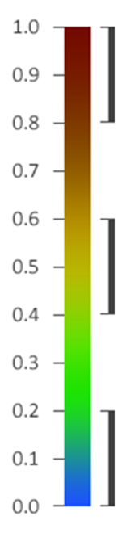
Objectives
Develop a device capable of calculating the crop water Stress index (CWSI) based on Leaf temperature measurements
Implement a leaf health scale that correlates with leaf temperature data, providing a practical tool for assessing plant health
CWSI =
TL : Leaf Temperature
Tw : Wet Reference Temperature
TD : Dry Reference Temperature
Crop is Exposed to high level of water stress
Plant is exposed to considerable stress from lack of Water
TL - Tw
TD - Tw
Crop is partially free of Water stress
https://link.springer.com/article/10.1007/s00271-022-00819-6 https://www.frontiersin.org/journals/plant-science/articles/10.3389/fpls.2020.609155/full
Portable System for Detecting Plant Stress

Slide 8
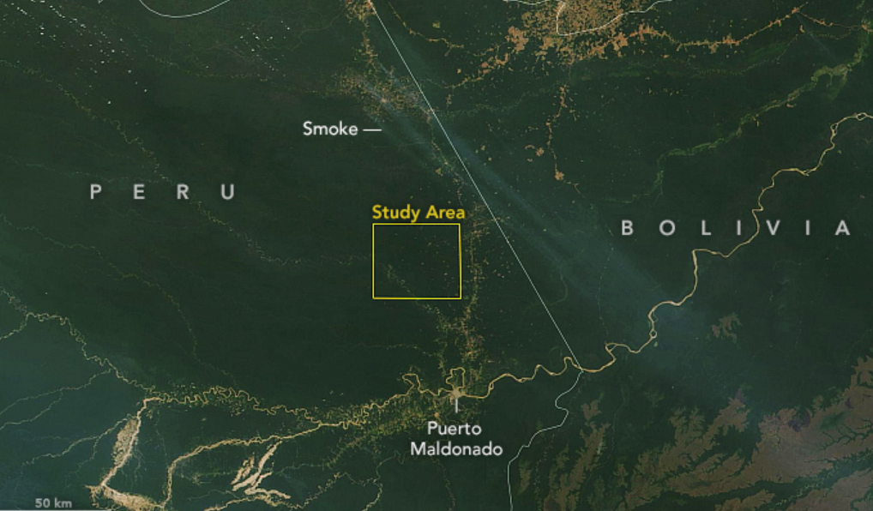
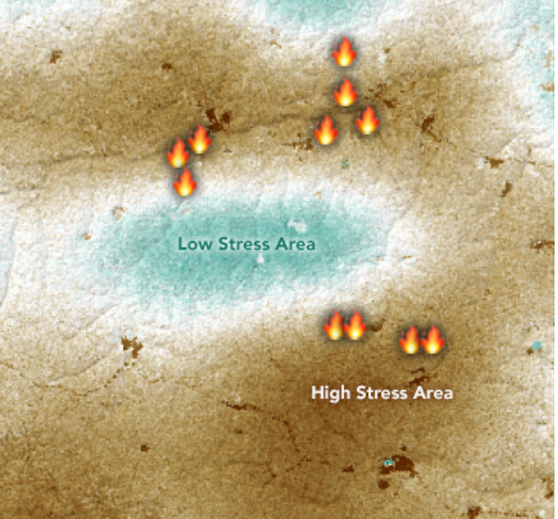
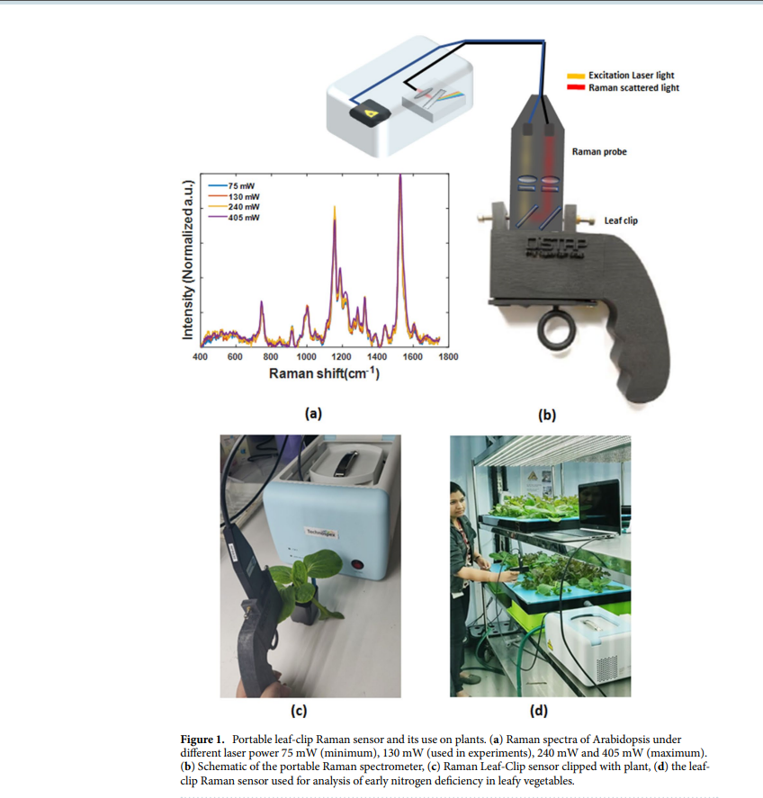
Available Solutions
Satellite Imagery: It uses machine learning algorithms to predict CWSI values by analyzing historical data.
Portable Raman Leaf Clip Centre : studies molecular vibrations to detect the status of plant leaves
https://earthobservatory.nasa.gov/images/145823/detecting-invisible-plant-stress
https://www.nature.com/articles/s41598-020-76485-5
Portable System for Detecting Plant Stress

Slide 9
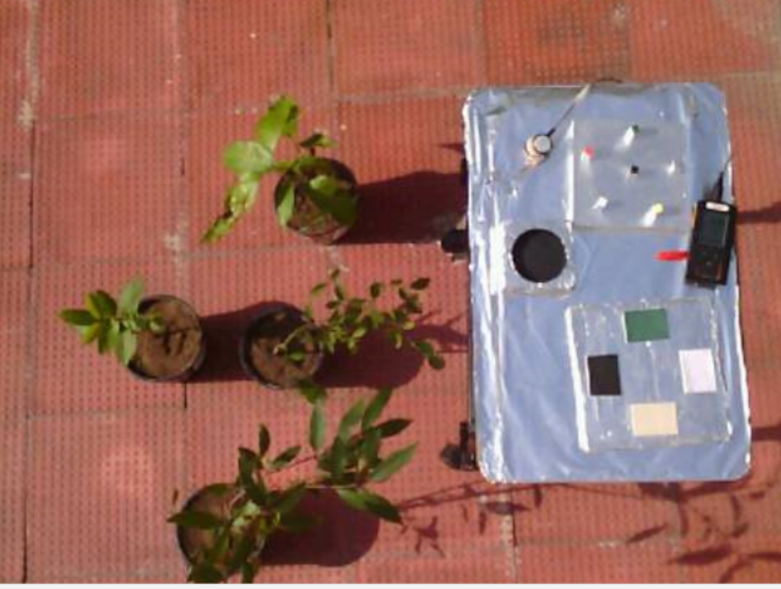
blob:https://web.whatsapp.com/852c6c1d-4e10-412c-bc8d-0db5b5e7c521
Experimental Procedure
Experimental Setup
Dry Surfaces
Plants
Solarimeter
Wet Surfaces
Portable System for Detecting Plant Stress

Slide 10
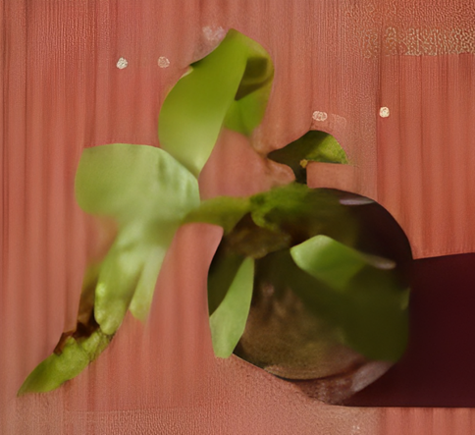
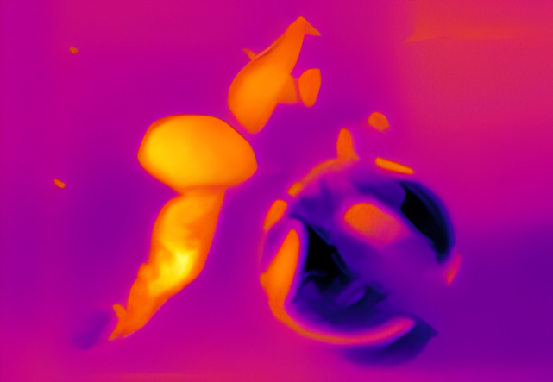
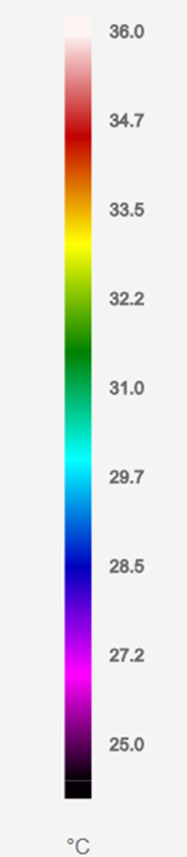
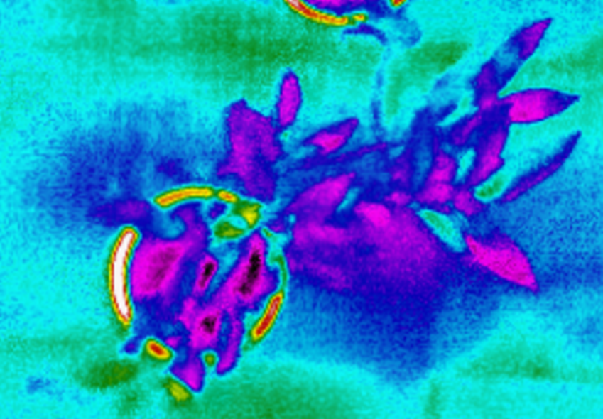
Experimental Procedure
Optical and IR Images :
Optical Image
IR Image
IR Temperature Scale :
Java Plum Plant
Portable System for Detecting Plant Stress

Slide 11
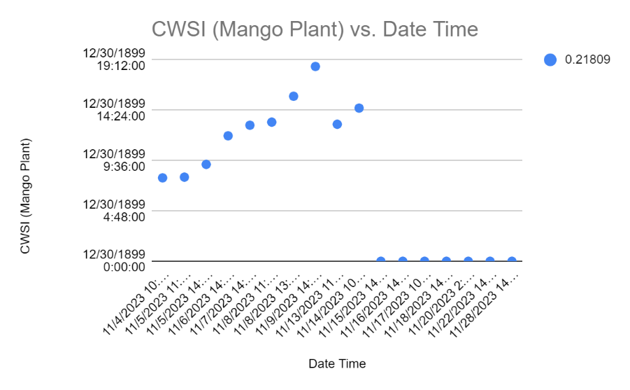
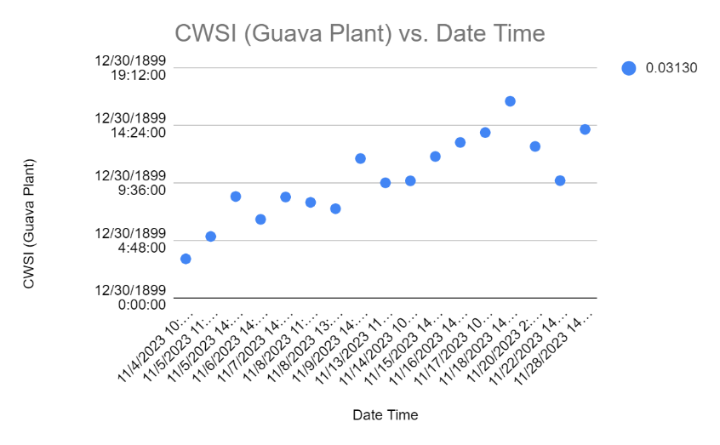
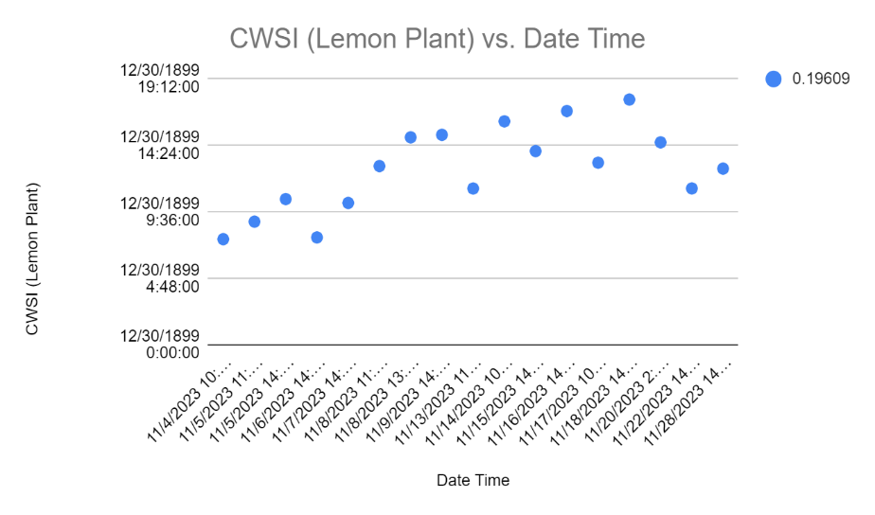
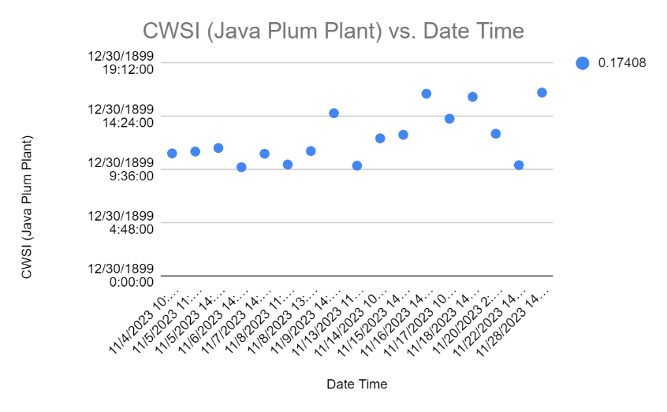
Experimental Procedure
Variation of CWSI
https://docs.google.com/spreadsheets/d/1v4vwyYS-CgRQhTB_QnavkTkGthdox7yO/edit?usp=sharing&ouid=104655483092176756320&rtpof=true&sd=true
Portable System for Detecting Plant Stress

Slide 12
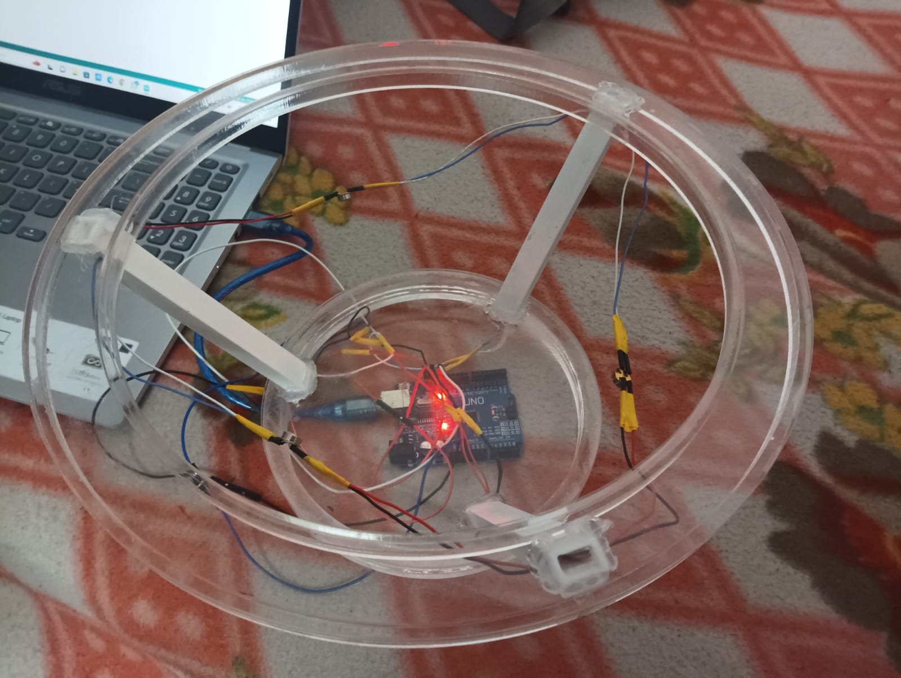
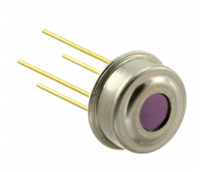
Our Product
Measurement resolution | 0.02°C
Sensing Temperature | -70°C ~ 380°C (IR)
Accuracy - Highest (Lowest) | ±0.5°C (±4°C)
Portable System for Detecting Plant Stress

Slide 13
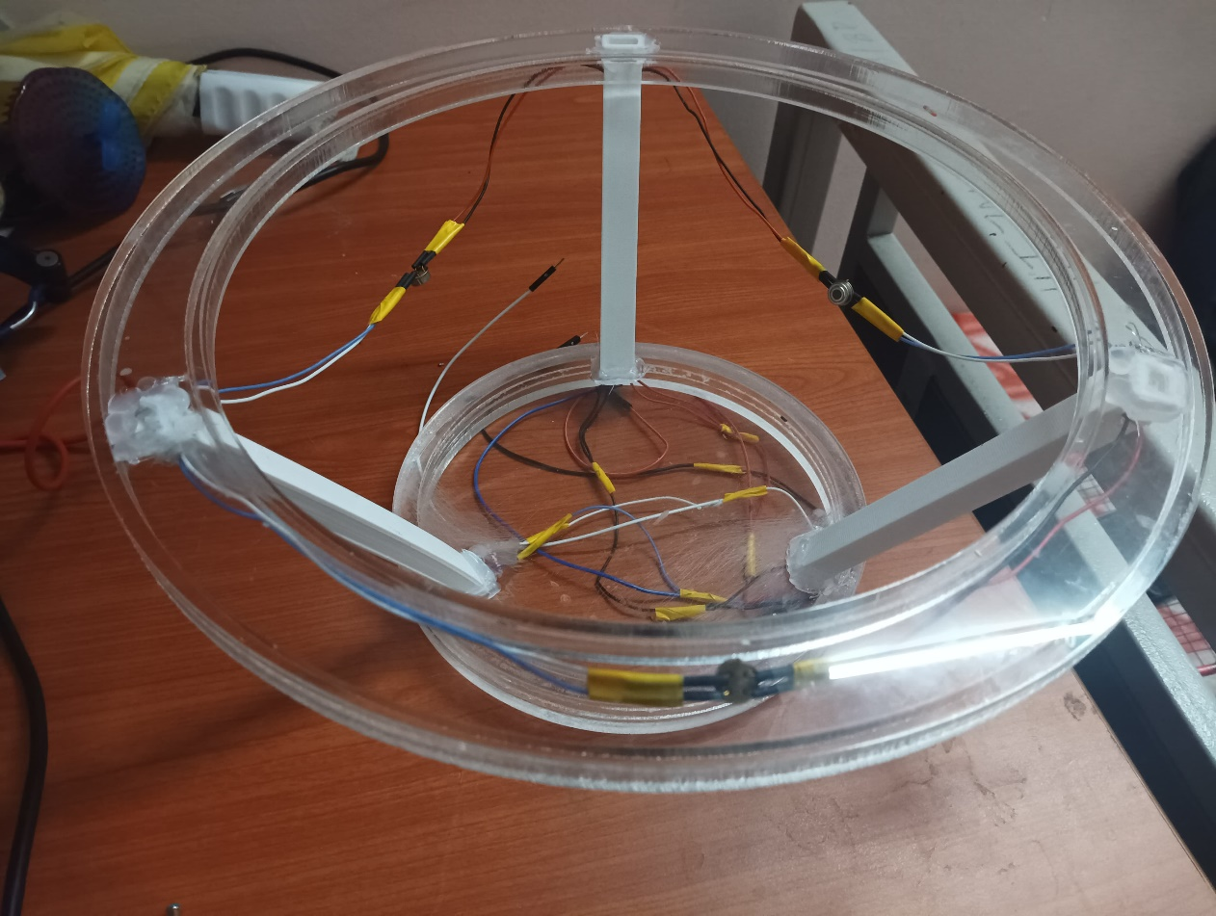
Advantages of Our Product
Portable
Cost effective
Easy to use
Time saving
Easy to assemble
Portable System for Detecting Plant Stress

Slide 14

2
Image Processing of Pebbles

Slide 15
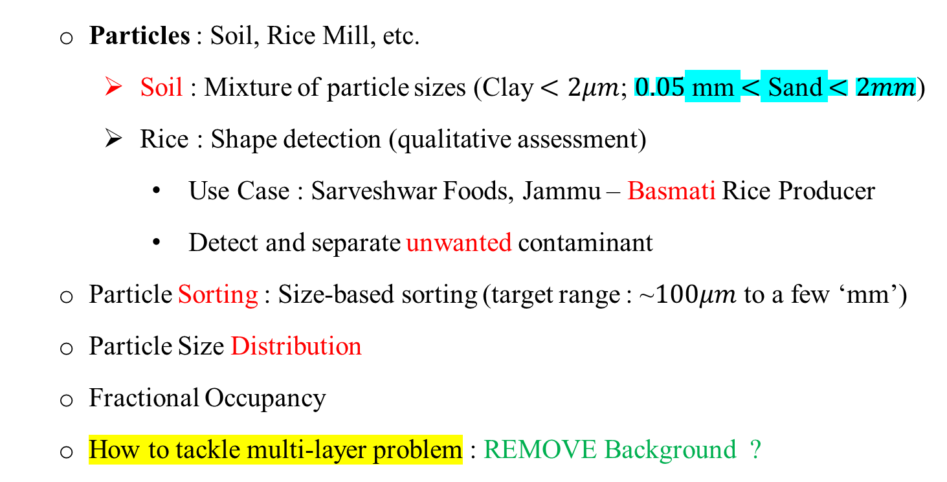
Motivation and Practical Relevance
Particles : Soil, Rice Mill, etc.
Soil : Mixture of particle sizes (Clay $<2μm$; $0.05$ mm $<$ Sand $<2mm$)
Rice : Shape detection (qualitative assessment)
Use Case : Sarveshwar Foods, Jammu – Basmati Rice Producer
Detect and separate unwanted contaminant
Particle Sorting : Size-based sorting (target range : ~$100μm$ to a few ‘mm’)
Particle Size Distribution
Fractional Occupancy
How to tackle multi-layer problem : REMOVE Background ?
Image Processing

Slide 16
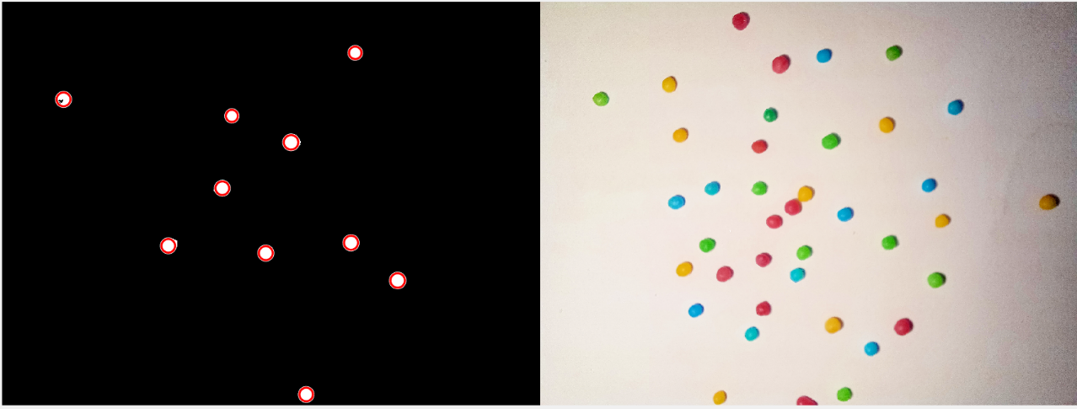
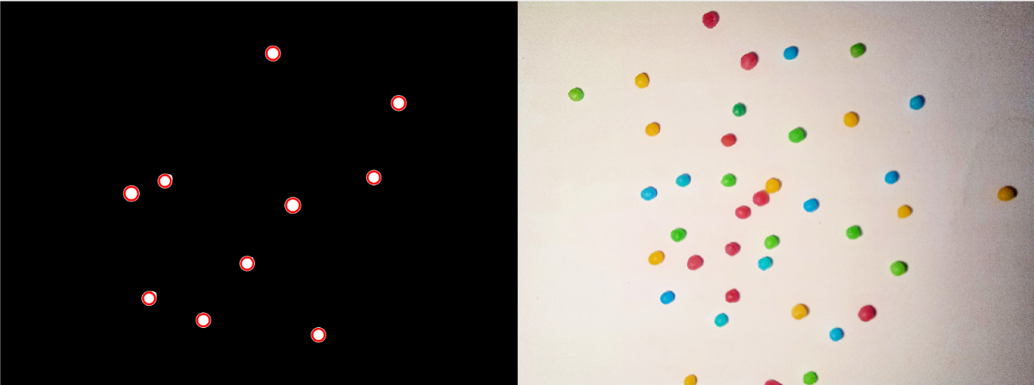
Progress
Segmentation on the basis of colours
Here we have done image segmentation and edge detection for spherical balls.
In the first and second images we have segmented the images based on Green and blue colours.
Here the fractional occupancy of green balls is 0.2215 % and the fractional occupancy of blue balls is 0.2068%.
Image Processing
Image Processing

Slide 17
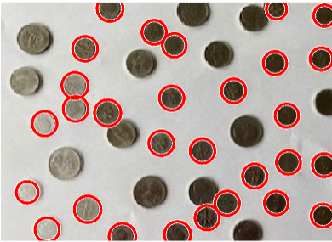
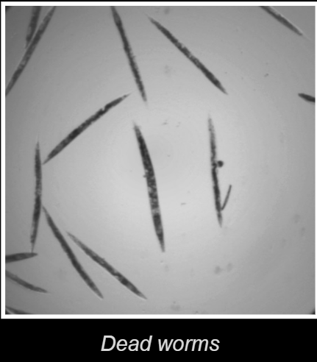
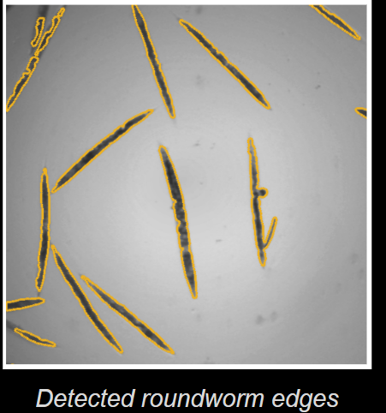
Progress
Edge detection on the basis of size:
In this image coins are detected on the basis of size.
Edge detection on the dead worms:
Here we have detected the edges of random shapes.
Image Processing

Slide 18
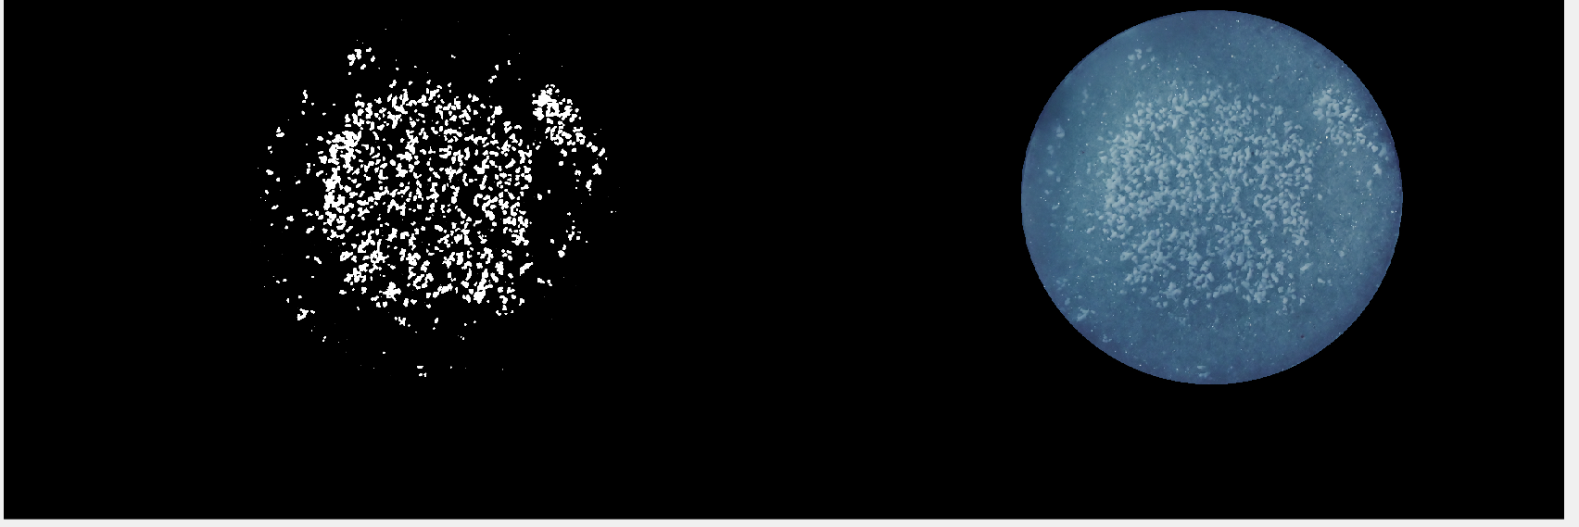
Progress
Image segmentation of the salt particles
With the help of image segmentation we can also process the fine particle of salt
All it’s need a good image and we can calculate the area of the salt covered .
Image Processing

Slide 19
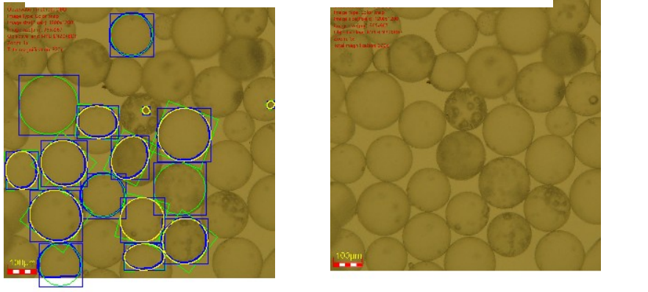
Currently available methods for particle size analysing
Currently Malvern Panalytical makes machinery to measure particle sizes. Eg :
Mastersizer 3000+
Spraytec
Nanosight pro
This image is from Biovis where we can see sphericity of micro size particle.
Image Processing

Slide 20
Contributions
Yuvraj Chugh
Shivani Chauhan
Portable System for Detecting Plant Stress

Slide 21
THANK YOU

